Slide 1

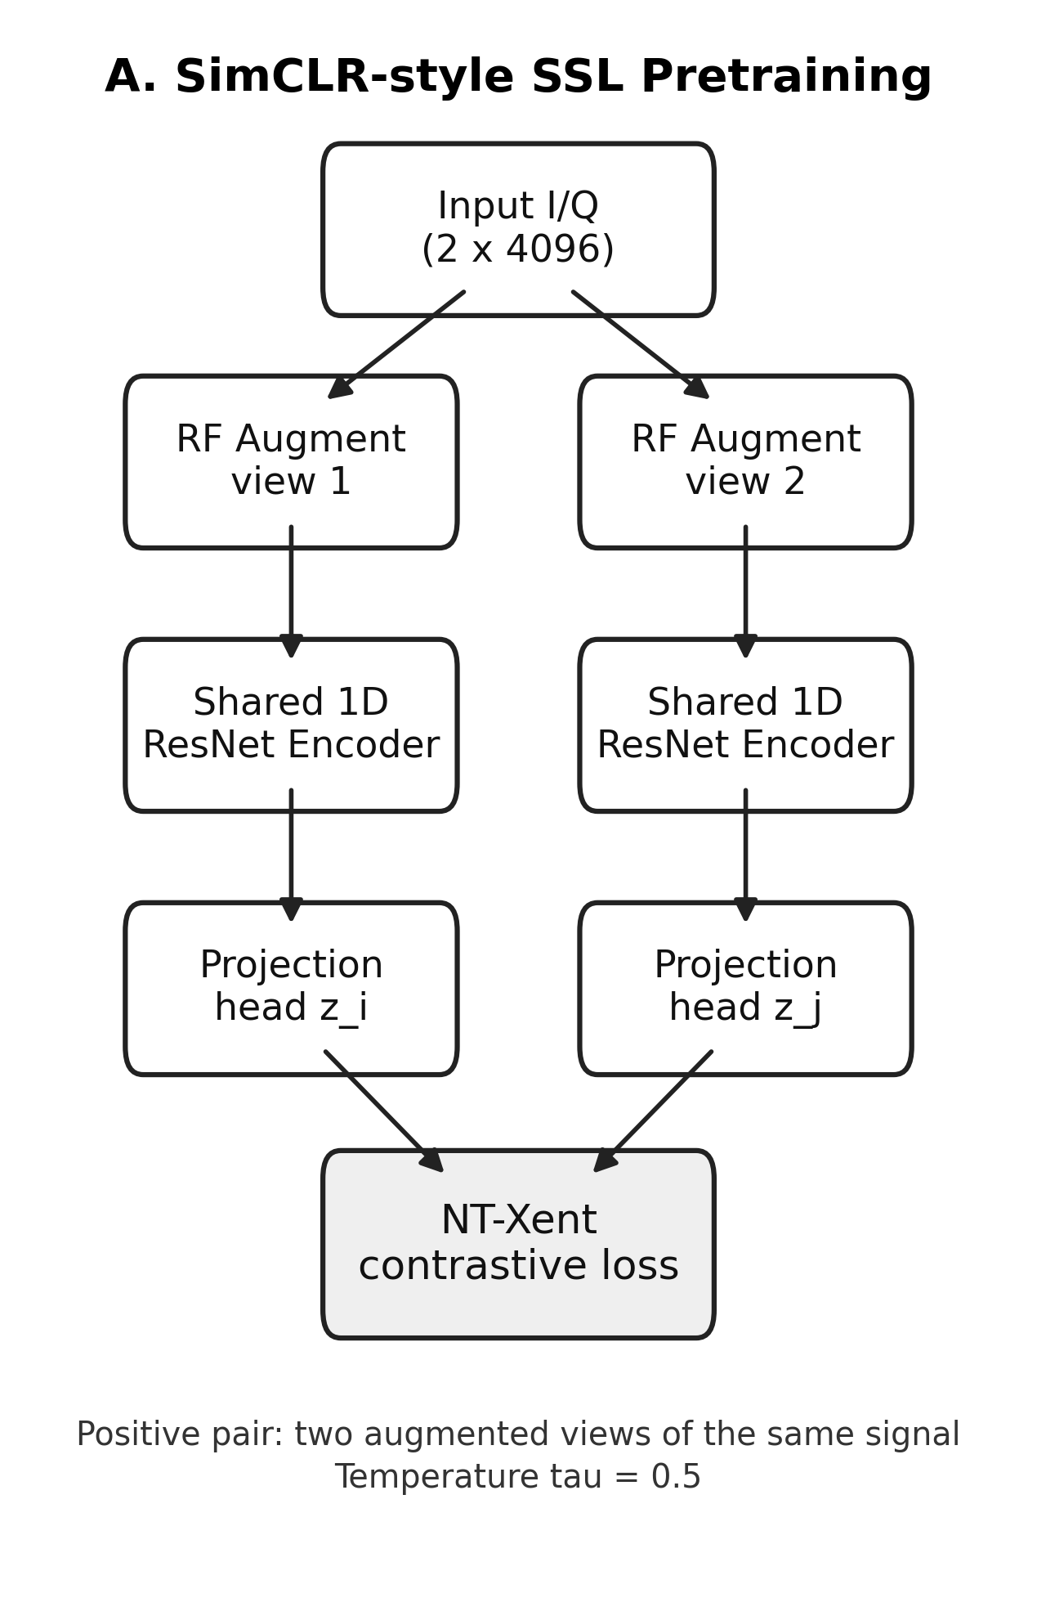
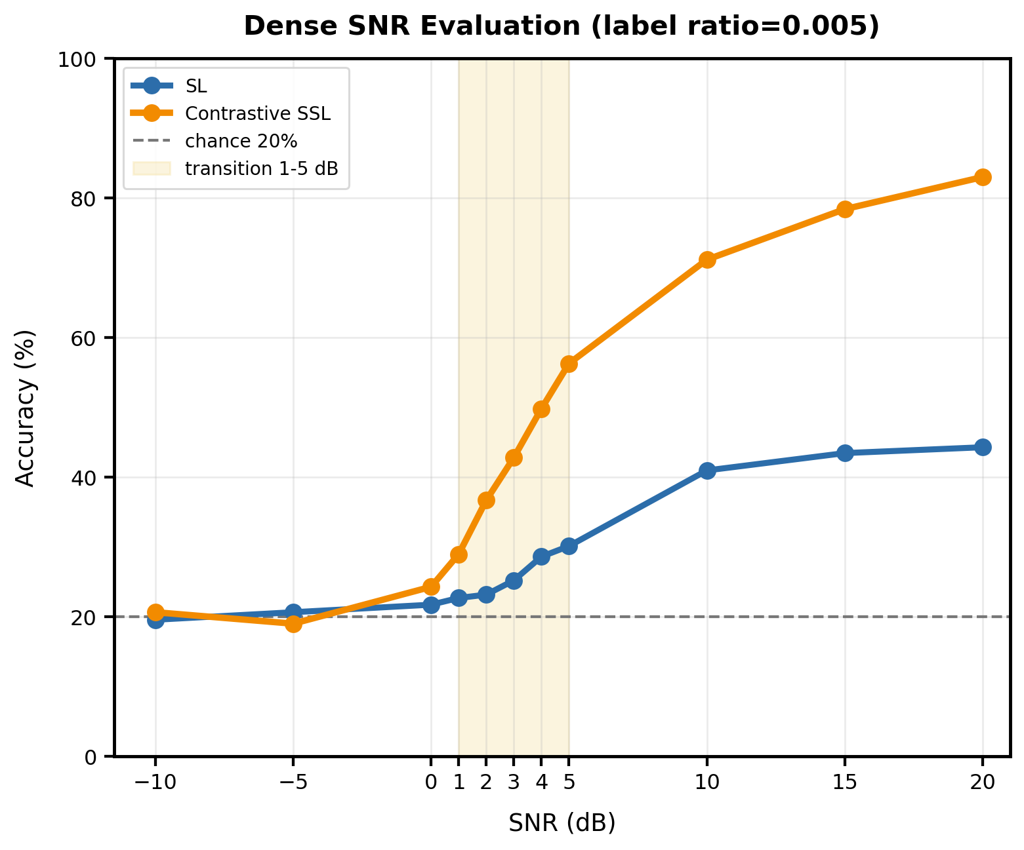
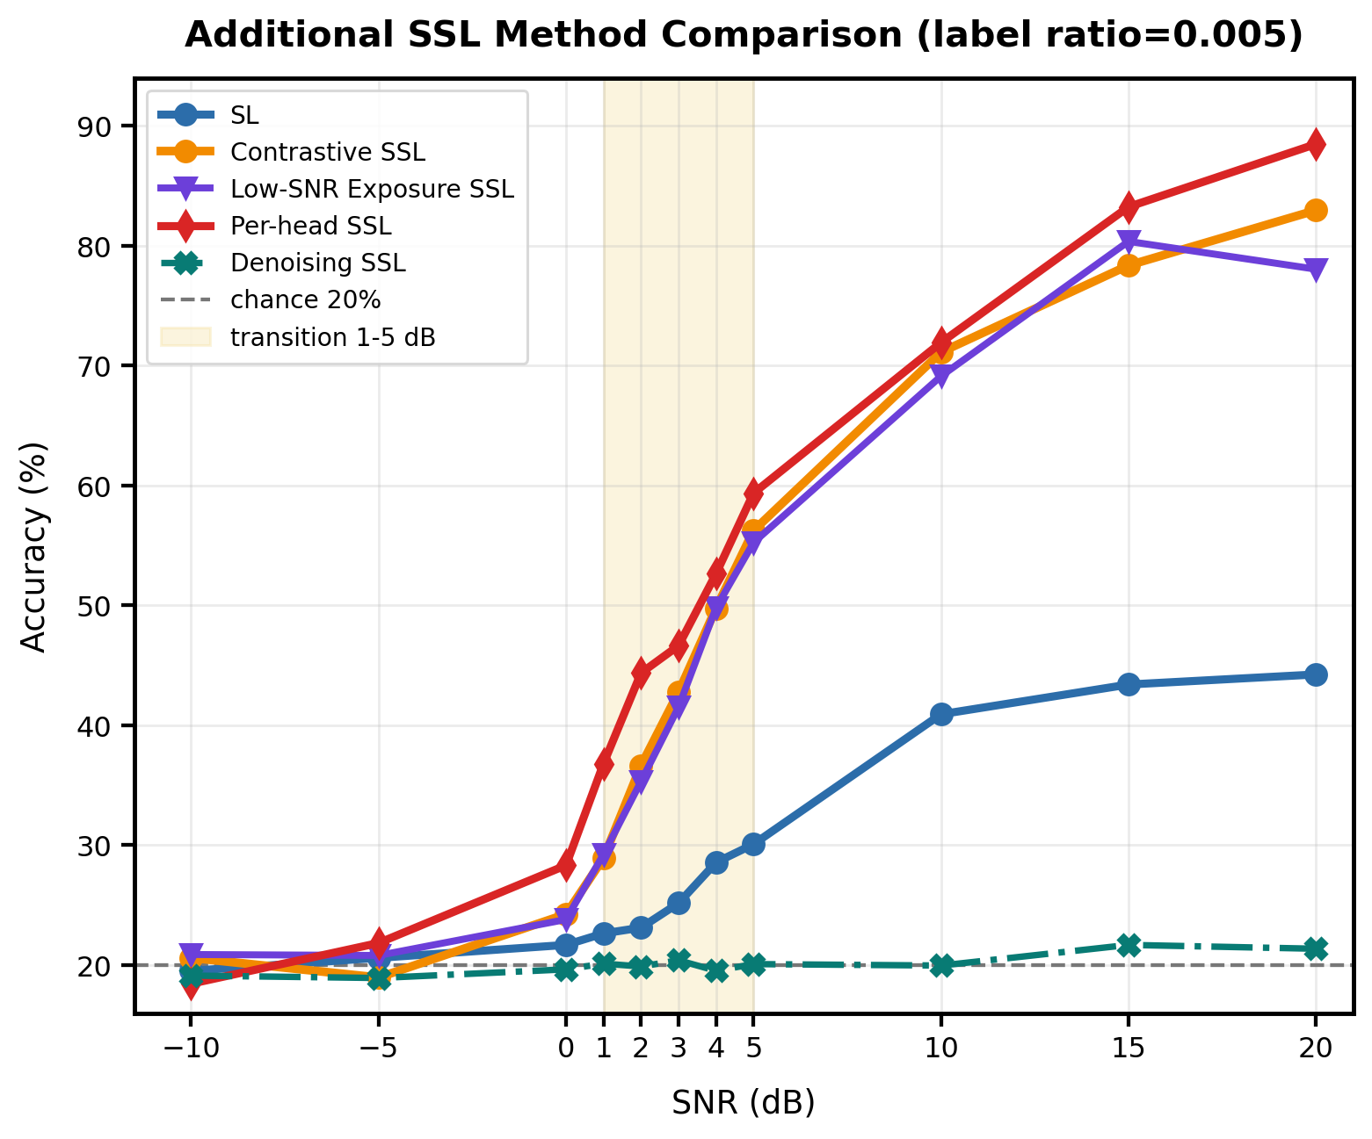
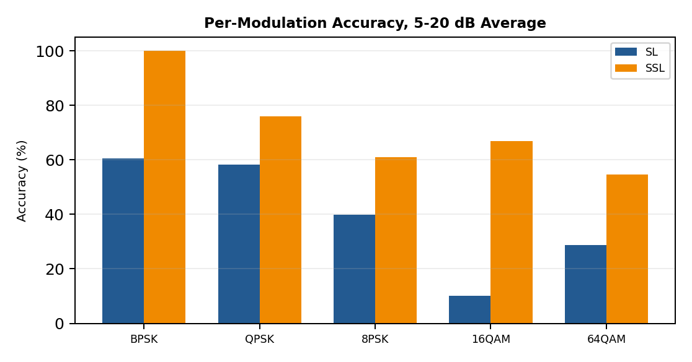

Self-Supervised Modulation Classification under Varying SNR
Label-Efficient I/Q Modulation Classification with Contrastive Pretraining
Woo, Jun Ha | School of Electrical Engineering, Korea University | jerry229@korea.ac.kr
1. Motivation / Setup
Current trend:
RF systems increasingly require automatic modulation recognition.
Machine learning-based classification research has become increasingly active.
Data issue:
Labeled I/Q datasets are costly to build,
while unlabeled RF signals are relatively easy to collect.
SSL idea:
Step1. pretrain an encoder using SimCLR-style
Step2. fine-tune encoder+classifier with few labels.
Research focus:
Identify which SNR regimes actually benefit from SSL under scarce labels.
Item | Setting
Task | 5-class I/Q modulation classification
Modulations | BPSK, QPSK, 8PSK, 16QAM, 64QAM
Input | 2 x 4096 I/Q samples
Label ratio | 0.25% 0.5%, 1%
Train SNR | 0, 5, 10, 15, 20 dB
Dense test SNR | -10, -5, 0-5, 10, 15, 20 dB
Models | SL, contrastive SSL, additional SSLs
2. Low-label SL vs SSL Gain
SL -> SSL gain at label ratio 0.005
High
Region | SL | SSL | Gain
Severe | 20.06 | 19.78 | -0.28
Transition | 25.21 | 39.76 | +14.55
High | 42.85 | 77.48 | +34.63
Transition
Severe
Ratio | Transition | High
0.25% | +14.65 | +49.52
0.5% | +14.55 | +34.63
1% | +13.25 | +32.21
SSL shows limited benefit in the severe low-SNR region, where the received signal is too noisy for meaningful class separation. However,
clear gains appear in the transition and high-SNR regions, and these
gains remain consistent even when the label ratio is reduced from
1% to 0.25%. This indicates that SSL is most effective not simply
when labels are scarce, but when the signal still contains recoverable modulation patterns.
3. Added Methods and Per-head SSL Gain
High
Method | Role
SL | SL baseline
SSL | SSL baseline
Low-SNR Exposure SSL | Severe-SNR extra training
Denoising SSL | Loss reconstruction
Per-head SSL | SNR-aware multi-classifier
Transition
Region | SSL | Per-head | Gain
Severe | 19.78 | 20.14 | +0.36
Transition | 39.76 | 44.69 | +4.93
High | 77.48 | 81.21 | +3.73
Overall | 46.41 | 50.19 | +3.77
Severe
Among the additional methods, Per-head SSL achieved the most consistent improvement in transition and high-SNR regions.
This suggests that SNR-specialized classification heads can better capture modulation characteristics that vary across noise conditions.
Despite these improvements, performance under severe low-SNR conditions remains close to random guessing, indicating that denoising alone is insufficient when signal structure is heavily distorted.
4. Per-Modulation Analysis
5. Takeaway
SSL is effective under scarce labels, but mainly in recoverable SNR regimes.
Per-head SSL adds the clearest improvement by specializing the classifier to SNR regimes.
Severe -10/-5 dB remains near chance, and noise exposure or denoising alone is not enough.
SSL improves the accuracy of all modulation classes compared with SL, including relatively simple modulations such as BPSK. The gain becomes especially noticeable for higher-order modulations such as 16QAM and 64QAM, where class boundaries are more sensitive to noise and limited labels. Overall, the result suggests that SSL helps the encoder learn more robust and transferable RF signal representations across different modulation types.
Paper link : https://drive.google.com/file/d/1FDF5CY6ctDSozptARpYvBXt6I2PMM-8b/view?usp=drive_link

